Slide 1
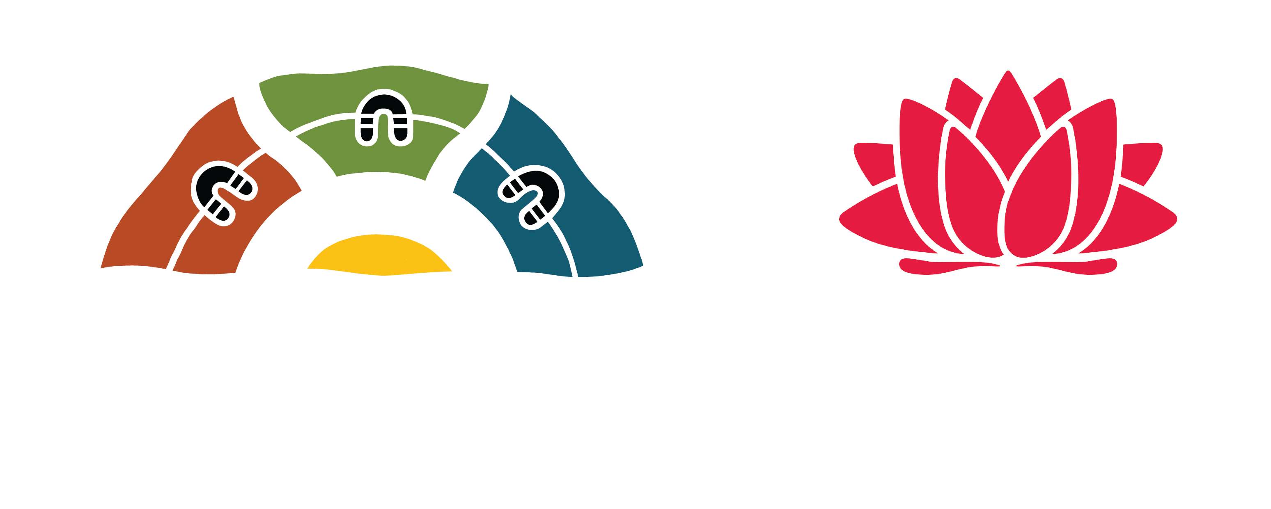
Getting to know NSW Aboriginal Languages Languages Alive, Culture Thrives

Slide 2
Did you know? In NSW, there are over 35 distinct Aboriginal Languages that are spoken on different Countries from the ocean, along the rivers, over the mountains and on the red dirt.
Aboriginal Languages have been used all over NSW for time immemorial. There are Languages for every part of this state.
What is the local Language (or Languages – there might be more than one) in your local area?

Slide 3
Did you know? From 1909 to 1969 Government Policies on Aboriginal Education stopped Aboriginal Children from speaking their Languages.
Some past Government policies and legislations like the Aborigines Protection Act 1909, didn’t allow Aboriginal children to learn or speak their Languages.
Aboriginal children were taken away from their families, Languages and Culture. These children are now known as the Stolen Generations.
How is the Aboriginal Languages Act 2017 different to the old Aborigines Protection Act 1909?

Slide 4
Did you know? Right now, Aboriginal Languages are being revitalised and people are starting to speak them again?
Aboriginal Languages all over NSW are being revitalised and Aboriginal people are starting to speak their Languages again.
Listen to the song Yandool by Stiff Gins in Wiradjuri Language. What area in NSW does Wiradjuri Language come from?
Watch the film Freedom to Speak. How does the Gumbaynggirr Gingana Freedom School help to revitalise Gumbaynggirr Language?

Slide 5
Did you know? Aboriginal Languages are embedded in kinship, songs, stories and ceremony. These are considered a sacred expression of Country and Dreaming.
Aboriginal Language Groups express their stories in their Languages through song and dance.
Watch Dance Rites 2021. Can you identify the name of a Dance Group, where are they from and what story is their dance telling?
What the Language Journeys films. What do Andy and Barkaa say about why learning their Language is important?

Slide 6
Did you know? Many towns, places and even streets around NSW have Aboriginal Language names.
Placenames might use the original name of an area, or a word or phrase in an Aboriginal Language can be given to a new place.
Watch the Marrambidya Bila film. Where did the name Marrambidya Bila come from?
Can you think of any places in your local area that might have been named in an Aboriginal Language?

Slide 7
Did you know? Aboriginal Languages use different sounds and pronunciations to Australian English.
For example, many Aboriginal Languages roll the letter ‘rr’ to make a trill sound. This is done by vibrating the tongue behind the top of the teeth. Other Languages use the ‘ng’ sound found in words like ‘singer’ at the start of their words.
Listen to some of the Language sounds on the 50 Words Project and the Common Sounds video.
Watch the Common Sounds in Our Languages film. Have a go at making rr and ng sounds. Trying to say ‘rra’ and ‘nga’.

